Slide 1

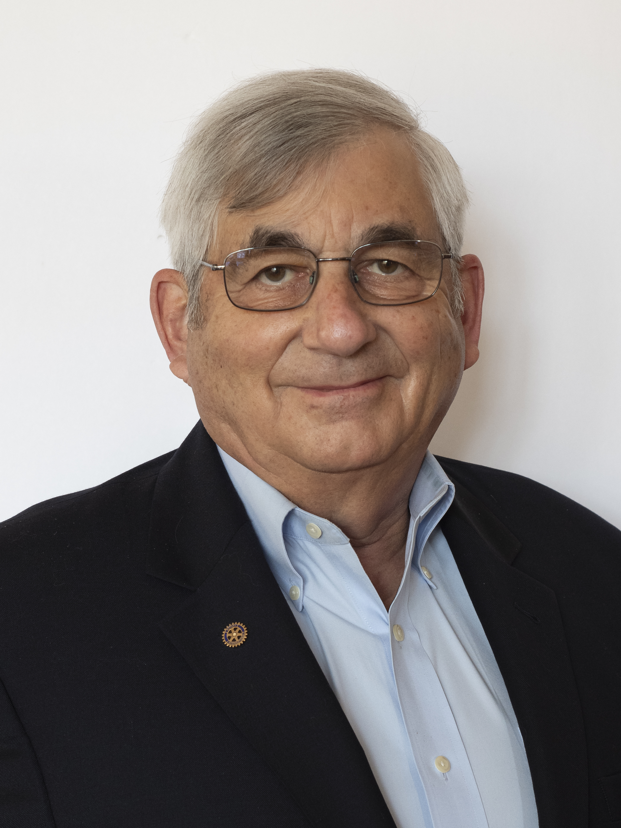
ROTARY INTERNATIONAL · YOUTH PROGRAMS
Interact
Rotary's service and leadership club for young people—and how it works across the United States
Longwood Rotary
District Interact Coordinator
Rob Newman
Rotary District 7540 Interact Coordinator
Cell: 484-574-9633
EMail: Interact@RotaryDistrict7450.org
www.rotarydistrict7450.org/interact

Slide 2



What Is Interact - Who It's For
A Rotary-sponsored club where teenagers turn everyday energy into community impact
Open to students ages 12 to 18, in middle school, high school, or the wider community
Each club is organized and guided by a nearby Rotary club, which acts as sponsor, mentor, and project partner
Members elect their own officers and run the club themselves—Rotarians coach from alongside, not from the front
Clubs are largely self-sufficient, raising what little funding they need rather than depending on their sponsor
Build Leadership
Members run meetings, elect officers, and manage real projects from the ground up
Serve the Community
Hands-on projects address needs right at home—schools, neighborhoods, and local causes
Connect Internationally
Partnerships and projects abroad build understanding of cultures beyond their own

Slide 3
How an Interact Club Comes Together
From a sponsoring Rotary club's idea to an officially chartered Interact club—at no cost
1
2
3
4
A Rotary club commits to sponsor
Students organize & elect officers
The club applies for a charter
Rotary issues the charter
A local Rotary club identifies interested students and agrees to guide the new club as mentors and partners
Young members form the club, choose their own leaders, and shape the activities they want to pursue
The sponsor submits a charter application to Rotary International - NO fee required to apply
A certificate is mailed to the sponsor club's president, and the Interact club is officially recognized worldwide
Interactors work alongside their sponsor Rotary club on service projects, leadership activities, and international-understanding initiatives all year long.
Sends Updated Certification to RI Each Year

Slide 4




What an Interact Year Looks Like
Every chartered club commits to two anchor projects—plus the everyday work of growing as leaders
A community project
An international project
At least one service project each year that benefits the club's own school or local community.
At least one project that furthers understanding and connection with people in other countries.
Mentorship from Rotarians
Leadership that grows
Sponsor-club members work side-by-side with Interactors as guides, coaches, and project partners.
Members run their own meetings and budgets, building skills in planning, teamwork, and public speaking.

Slide 5
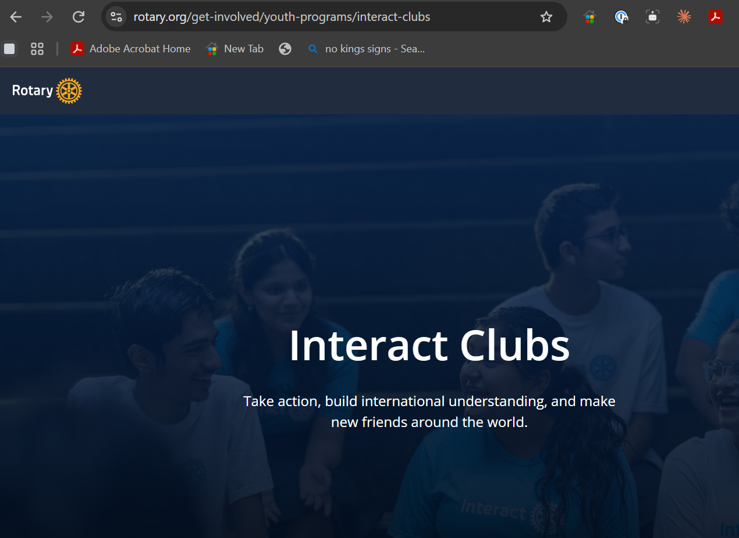

How to Do This?
Lots of resources to help YOU build an Interact Club
MY Rotary
is always a great
First Stop!
www.rotary.org/get-involved/youth-programs/interact-clubs

Slide 6
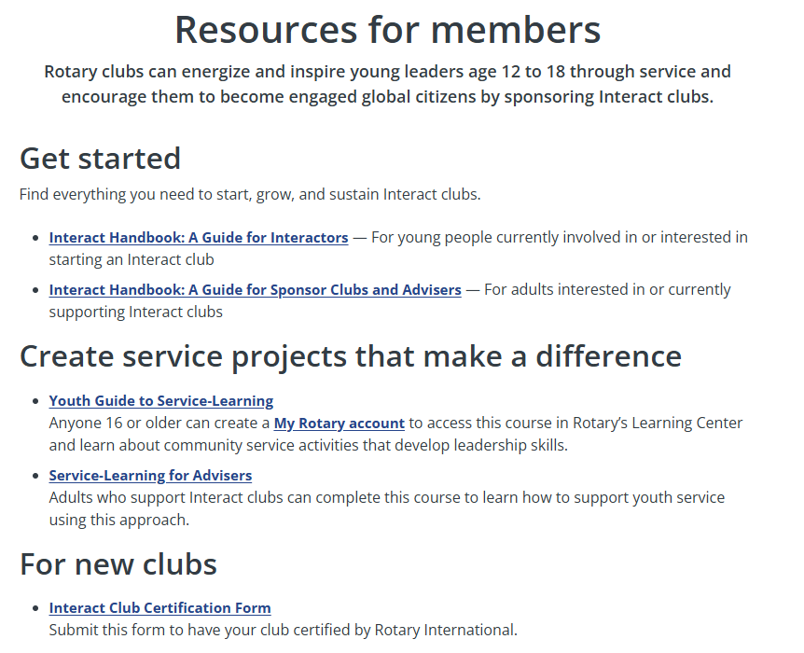
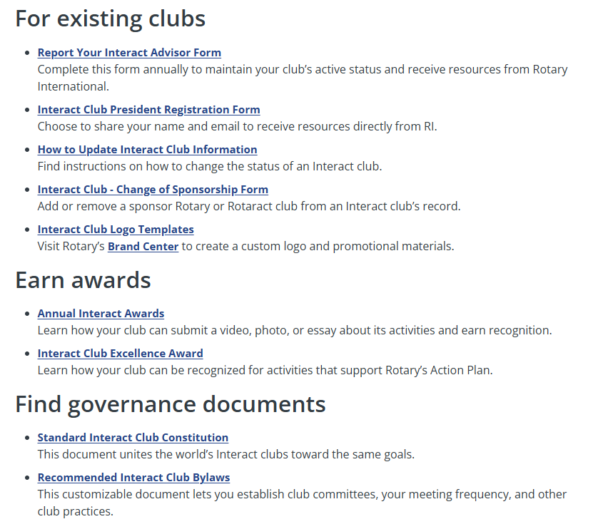
MY Rotary
is always a great
First Stop!
www.rotary.org/get-involved/youth-programs/interact-clubs

Slide 7
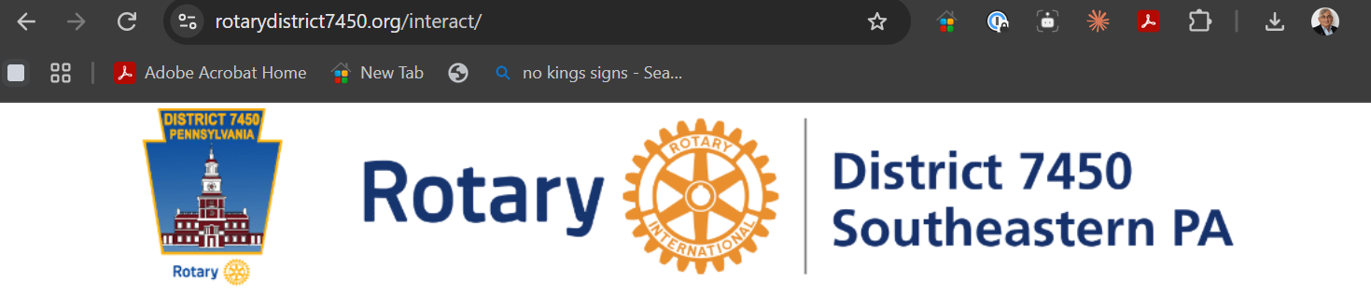
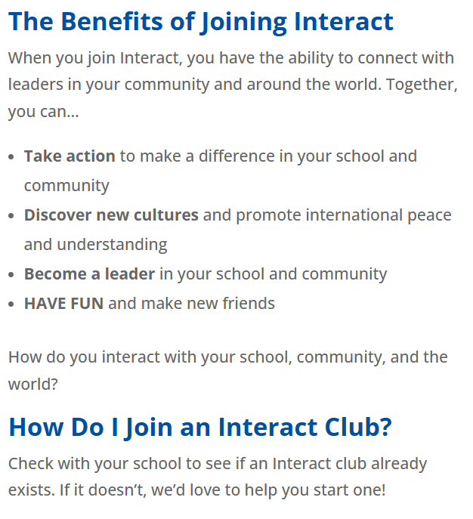
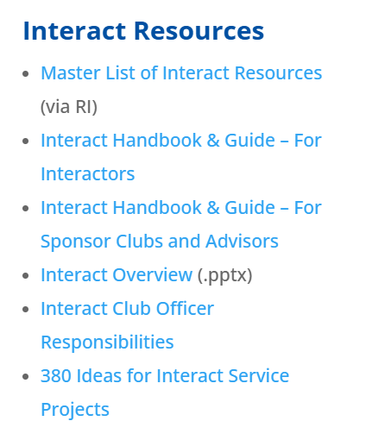
Want More Information?
Lots of resources to help YOU build an Interact Club
District Webpage with Links
www.rotarydistrict7450.org/interact/

Slide 8
Here in our District
17 ACTIVE I-Clubs
55 TERMINATED I-Clubs
Bensalem, Lionville, Chichester, Coatesville, Feasterville, West Chester Sunrise, Jenkintown, KOP, Langhorne, Longwood, Media, Newtown Sq, Oxford, Philadelphia, Swarthmore, Wayne, WeGo
Some are Clubs that lost leaders or disbanded
Many are ‘Active’ Clubs that did not send in ‘Proof of Life’ to RI for 2 yrs
For Students
For Your Club:
Opportunities to show Students Rotary In Action in your community
Sources of Volunteer Hours for Club Projects
Leadership Opportunities for Students
  RYLA
  Youth Exchange Program
  4-Way Speech Contest
Rob Newman
Rotary District 7540 Interact Coordinator
Cell: 484-574-9633
EMail: Interact@RotaryDistrict7450.org
www.rotarydistrict7450.org/interact

Slide 9

Just one example of a
FANTASTIC Interact Project!
Produced a true
Rotary Moment!

Slide 10

ROTARY INTERNATIONAL
The Rotaract Program
Young leaders in action - partners in service with Rotary
An introduction for Rotary club members

Slide 11
What is Rotaract?
Rotary's service club for young adults
Adults 18 and up who want to build leadership and professional skills through service. Rotary removed the upper age limit in 2019.
1
Who
Members organize their own clubs, manage their funds, and plan community and international service projects.
2
What they do
Clubs are university- or community-based, and each is sponsored by a Rotary club as a true partner in service.
3
Where
"Partners in service" - Rotaract clubs are self-governing and self-supporting, guided but not run by their sponsoring Rotary club.

Slide 12
Rotaract by the numbers
A global movement of young changemakers
225,000+
12,000+
180+
members worldwide
clubs
countries & regions
Since its founding in 1968, Rotaract has grown into one of the largest youth service networks in the world.

Slide 13
Action Items
: For Rotary Clubs
: For Interact Clubs
Do you have an Interact Club in your local school?
Is your I-Club listed as ACTIVE or TERMINATED?
Are you working with them?
Does Rob have Contact Info for your Club person?
Is your I-Club listed as ACTIVE or TERMINATED?
Are you in contact with Sponsor Rotary Club?
Does Rob have Contact Info for your Club?
Special Projects
Drive for More Participation in Leadership Opportunities for Students
Multi I-Club Service Projects
  Rise against Hunger, others
Discount Tickets for YoYo Ma Concert in December
  RYLA
  Youth Exchange Program
  4-Way Speech Contest
Rob Newman
Rotary District 7540 Interact Coordinator
Cell: 484-574-9633
EMail: Interact@RotaryDistrict7450.org
www.rotarydistrict7450.org/interact

Slide 14
ROTARY INTERNATIONAL · YOUTH PROGRAMS
Questions?
Rob Newman
Rotary District 7540 Interact Coordinator
Cell: 484-574-9633
EMail: Interact@RotaryDistrict7450.org
www.rotarydistrict7450.org/interact

