Slide 1
WELCOME PRESIDENTS-ELECT 2017-2018

Slide 2
Introductions
Training Team
- Matt Breidenstein, AG - Russ deFuria, PDG
- Dave Ellis, PDG
- Dwight Leeper, PDG
- Sue Mardinly, AG

Slide 3
Introductions
Assistant Governors
Area 1 – Chris Potter
Area 2 – Matt Breidenstein
Area 3 – Holly Lankin
Area 4 – Alan Simbo
Area 5 – Kevin Katarynick
Area 6 – Chuck Benz
Area 7 – Francy Cross
Area 8 – Dan Lievens
Area 9 – Bob Listerman

Slide 4
Introductions
Governor Line
District Governor Nominee-Designate Peter Mardinly
District Governor Nominee
Paul Quintavalla
District Governor Elect
Dawn deFuria

Slide 5
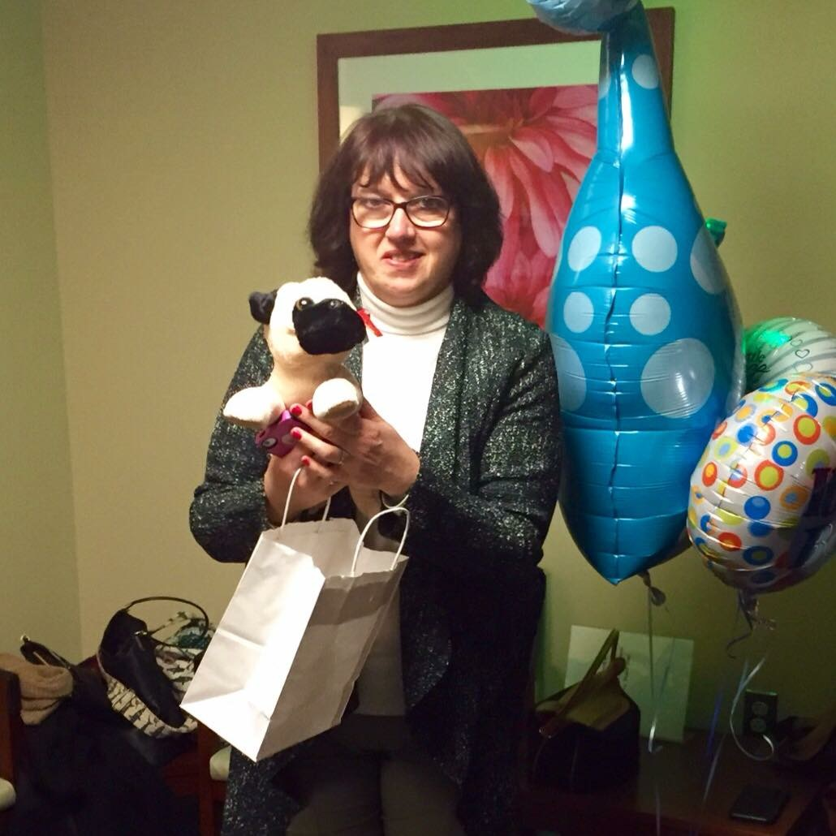
Our Year Together
Getting to know me !!!

Slide 6
The PEOPLE Business
P stands for pride
E stands for empathy
O stands for others and opportunity
P stands for persistence
L stands for leadership
E stands for excitement

Slide 7
President Ian Riseley

Slide 8
Presidential Citation

Slide 9
District 7450 Theme

Slide 10
Why, Why, Why???
What is PETS Orientation?
Why am I here?
What is PETS all about?
What can I expect?

Slide 11
What do you want???
“The District leadership structure
exists for one purpose…….
to serve the needs of the clubs and
to help you have the best year possible!”

Slide 12
Council on Legislation
Who: Representatives elected from all 535 districts around the world
What: Meet every 3 years
Where: Marriott Chicago
When: Next Meeting – April 2019
Why: Discuss & amend the rules that govern our organization

Slide 13
Significant Legislation
16-21 Meeting Flexibility - To allow for flexibility in club meetings & attendance (at least twice a month)
16-30 Meeting Flexibility – To revise attendance provisions to allow for in person and online participation

Slide 14
Significant Legislation
16-36 Membership Flexibility - To allow for flexibility in membership & classification (corporate, associate)
16-38 Membership Flexibility – To remove all additional criteria aside from being people of good character

Slide 15
Significant Legislation
16-40 Membership Flexibility - To allow Rotaractors to simultaneously be members of Rotary
16-99 Dues Increase – To ensure economic stability & continuation or improvement of services ($4 per yr)

Slide 16
Your Assistant Governor
What does the AG do?
What can I expect?

Slide 17
District Structure
Our district has 50 clubs in 9 areas
Each area has 5 or 6 clubs
Each area as 1 Assistant Governor

Slide 18
Role of the AG
AG Job #1 –
Keep the Governor informed of:
Your successes
Your issues
Your needs

Slide 19
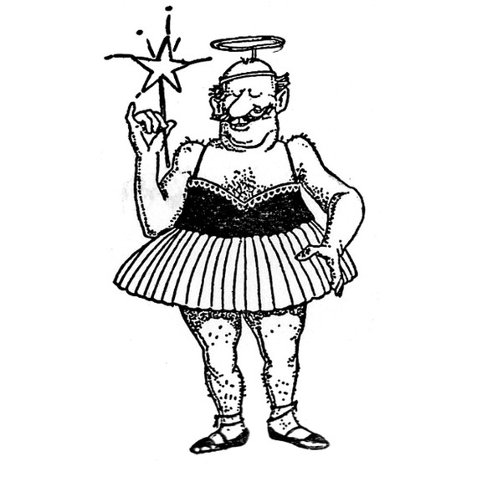
Role of the AG – Cont’d
AG Job #2 –
Be your “Fairy Godmother”
Your source of information & resources
Listens to your issues, advises & helps
Visits four times per year
…But has no authority over your club

Slide 20
Leadership 4 Minute Mile
“Potential and The Power of Belief”
Presented By Matt Breidenstein

Slide 21
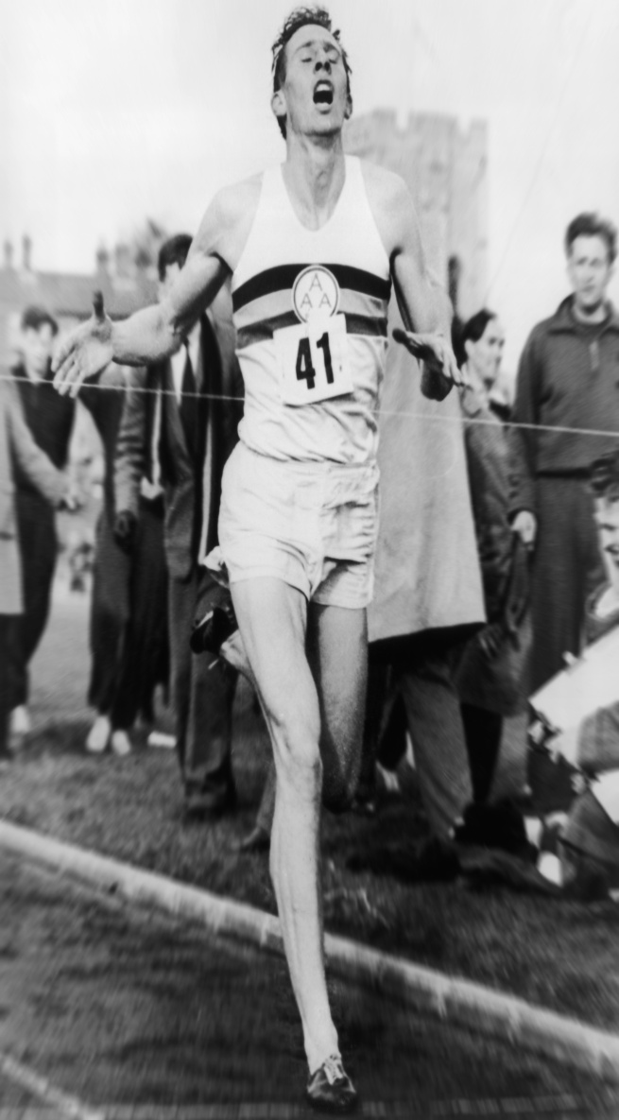
Leadership 4 Minute Mile
Roger Bannister

Slide 22
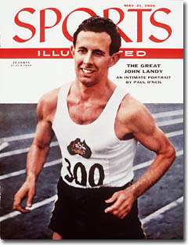
Leadership 4 Minute Mile
“Frankly I believe the four minute mile is beyond my capabilities. Two seconds may not sound much, to me its like trying to breakthrough a brick wall. Someone may achieve the four-minute mile the world is wanting so desperately,
BUT I DON’T THINK I CAN”
John Landy

Slide 23
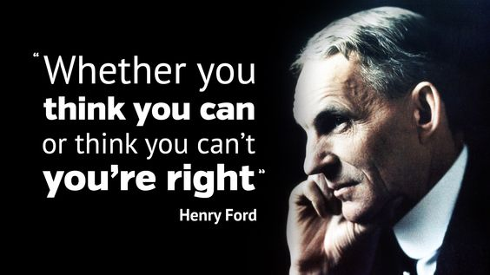
Leadership 4 Minute Mile

Slide 24
Membership
Three phases:
Development – Finding new members!
Retention – Hang on to our
most valuable asset!
Extension – New Clubs!

Slide 25
Women in Rotary
30th Anniversary of
Women in Rotary

Slide 26
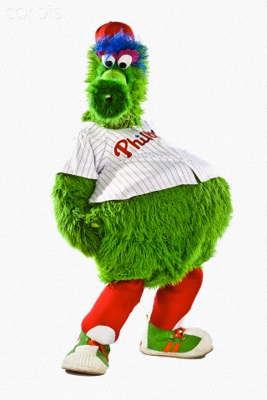
Rotary Night at the Phillies

Slide 27
Rotary Night at the Union

Slide 28
Our Rotary Mission
To provide service to others
Promote integrity
Advance world understanding, goodwill, and peace
Through our fellowship of business, professional, & community leaders

Slide 30
Imagine Rotary
What if there were no Rotary…
And you became aware of a problem
or need - at home or abroad
What would you do?
Who would you call?
How would you organize?

Slide 31
Rotary Areas Of Focus

Slide 32
District Action Groups
Cross-district groups of Rotarians
Expertise or interest in…
Professionally or personally involved with…
A Rotary Area Of Focus
Opportunity for sharing & collaboration
Opportunity for cross-club projects
Focus on mission, not process

Slide 33
District Action Groups (So far)
Fighting disease – 22 Members
Growing local economies – 26
Promoting peace – 29
Providing clean water – 19
Saving mothers and children – 20
Supporting education – 66
Vocational - 20

Slide 34
Think Hands On Service

Slide 35
Service Project Lifecycle
Selecting a project
Community Needs Assesment
Evaluation
Management
Funding
Partners
Planning

Slide 36
So before inviting people to your Club...
Notes:
What I learned

Slide 37
...Invite people to your cause…

Slide 38
DACdb (aka District & Club Database)
What is it?
Tool for Easily Managing Club and Member Records and Information
Automatically Updates RI
Club and District Calendar of Events
Club and District Event Registration
Custom and Pre-Defined Reports

Slide 39
DACdb (aka District & Club Database)
WIIFM?
Accurate Information
Available 24/7
Communication Tool for Clubs and the District through Pmail and Text
Club & District Dashboards-Key Measures
Monitor What Matters to You – 1 Screen

Slide 40
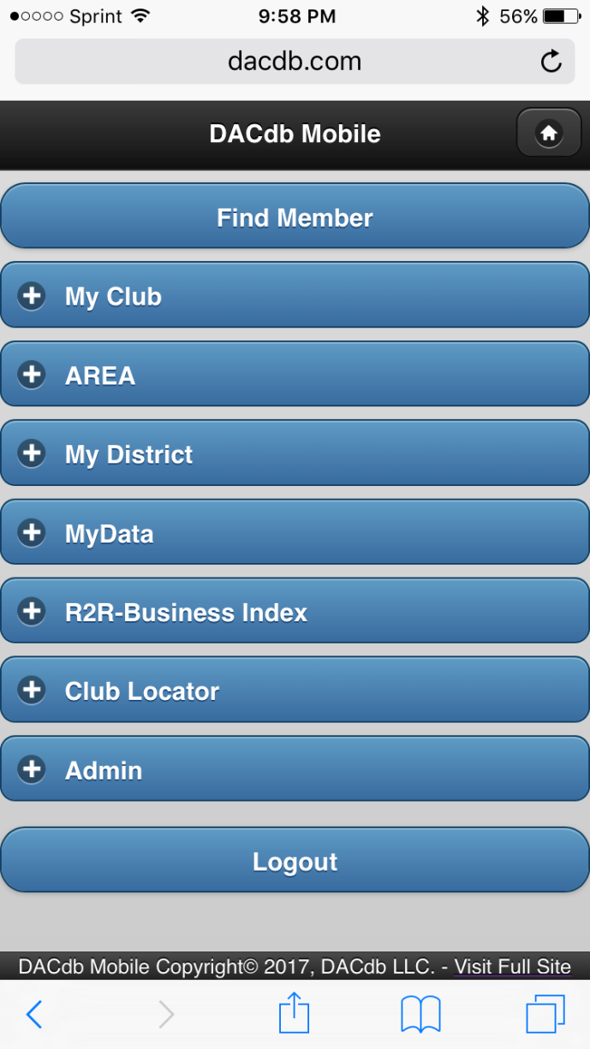
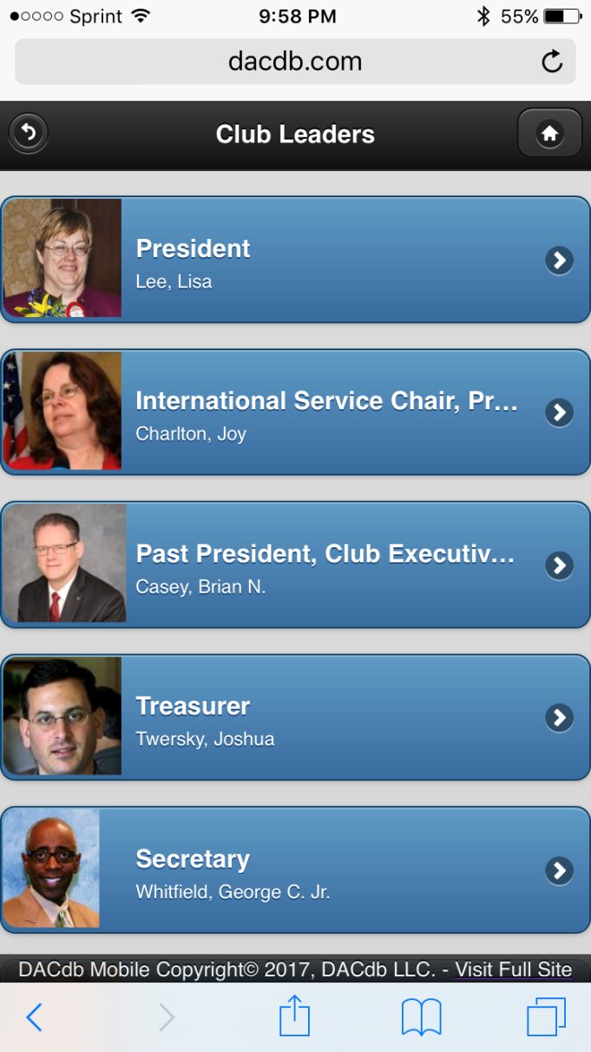
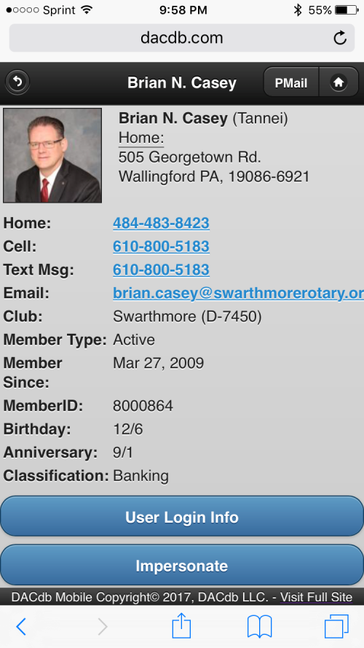
DACdb (aka District & Club Database)

Slide 41
Rotary Club Central
What’s in it for Clubs?
One-stop shop
Eliminated paper forms
Fosters continuity in leadership
Enable clubs to track their progress
Creates transparency
Showcases the important work that Rotary Clubs do around the world

Slide 42
Rotary Club Central
Who can use Rotary Club Central?

Slide 43
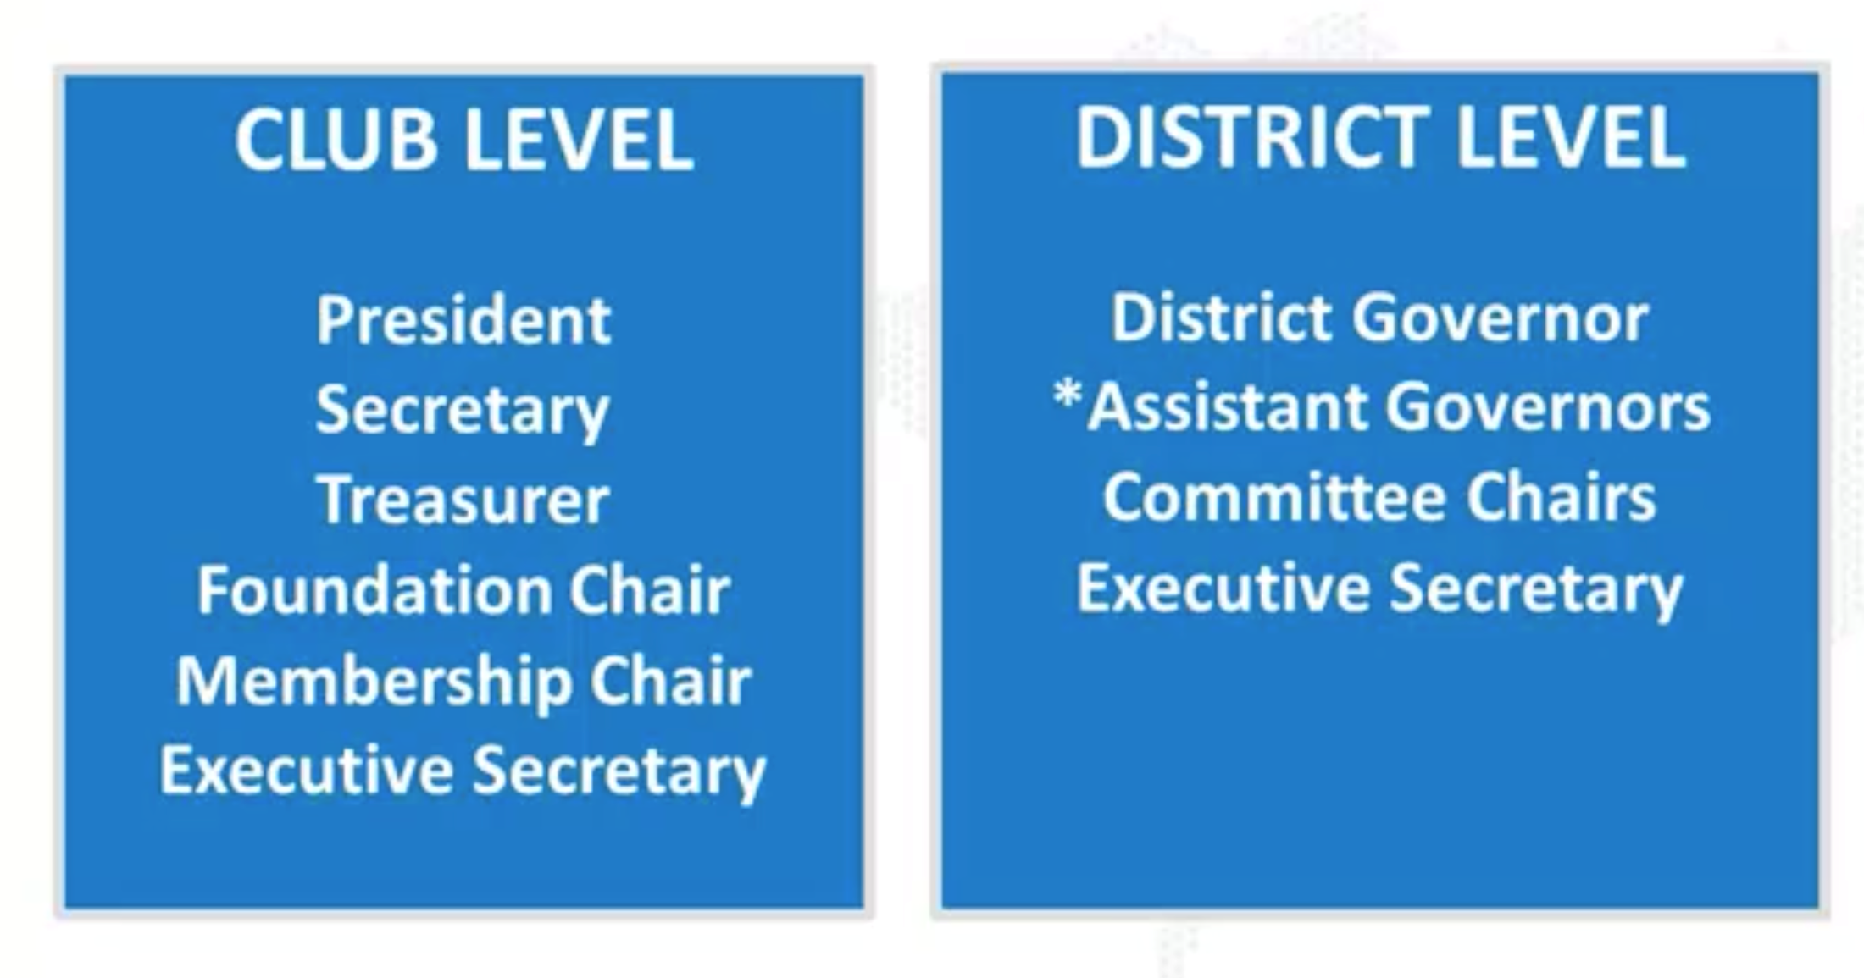
Rotary Club Central
Who can use Rotary Club Central?

Slide 44
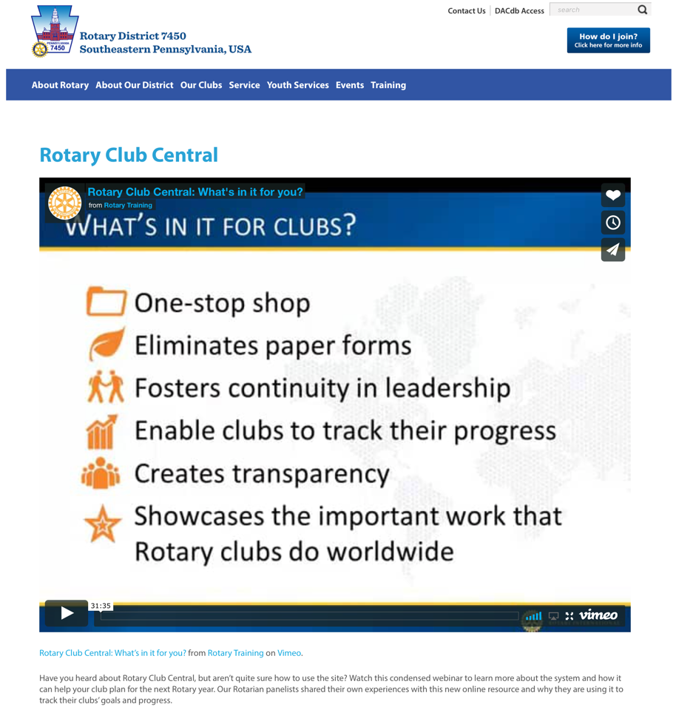
Rotary Club Central
RotaryDistrict7450.org/rcc

Slide 45
Communications
What works best for you?
Upgraded District website
Improved social media presence
Printed directory for this year’s team
Electronic newsletter monthly
Weekly video briefing ……..hopefully!

Slide 46
District Calendar of Events

Slide 47
Questions & Answers
Dawn deFuria
Dave Ellis
Brian Casey
???
Karen Mazzarella
Dwight Leeper
Bronwyn Martin
Paul Quintavalla
Matt Breidenstein
Russ deFuria

Slide 48
Thank You &
Welcome Aboard!

